Slide 1
Online medical service for patient system checker Safe and Reliable – for your peace of mind
Submitted by:
Yash Kumar -20BCS9256

Slide 2
INTRODUCTION
‘Medical care is something everyone needs, it can be easy to forget that medical care is a service and patients are customers. But good customer service is just as important in medicine as it is in any other field, and because people's health is so important, bad medical care or shoddy customer service might cause clients to complain to local licensing boards or engage in other actions that can harm a medical business

Slide 3
OBJECTIVE
This website is specially designed to htghhelp different peoples to classify their respective disease and their concern doctors.bnb

Slide 4
TECHNOLOGY USED
HTML
CSS
JavaSCRIPT
Bootstrap
PHP
VS-code

Slide 5
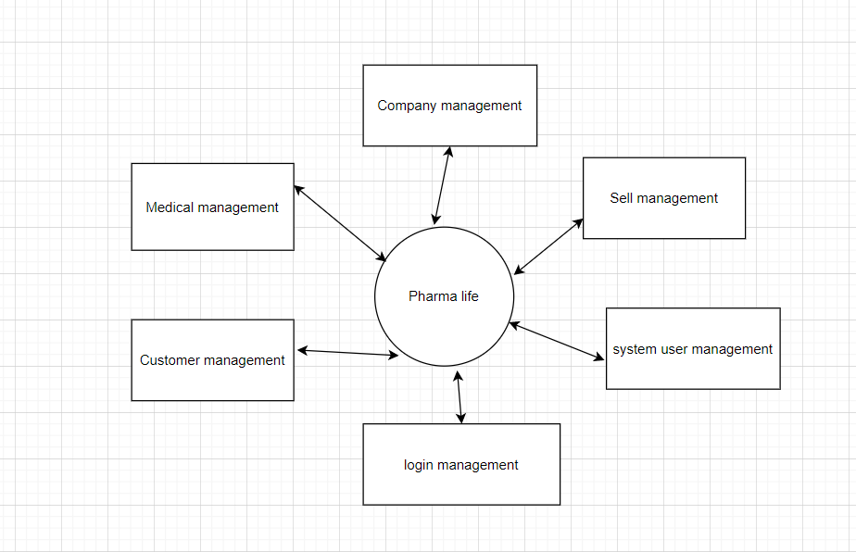
Design diagram
1.DFD (0 level)

Slide 6
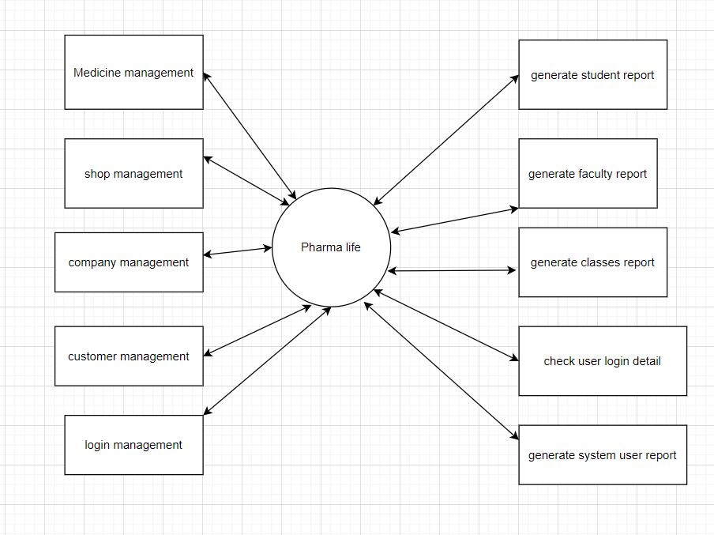
DFD(1-level)

Slide 7
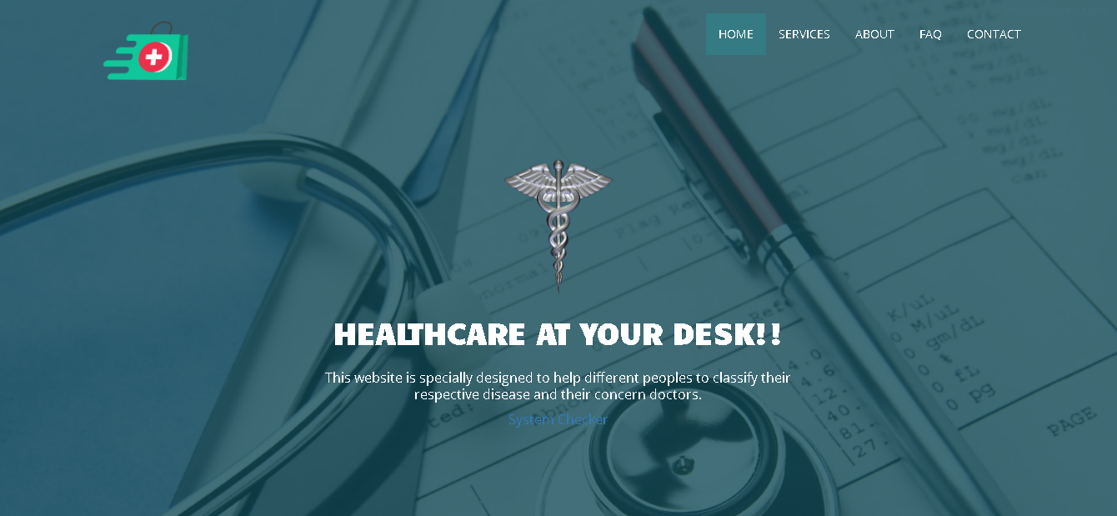
ScreenShot

Slide 8
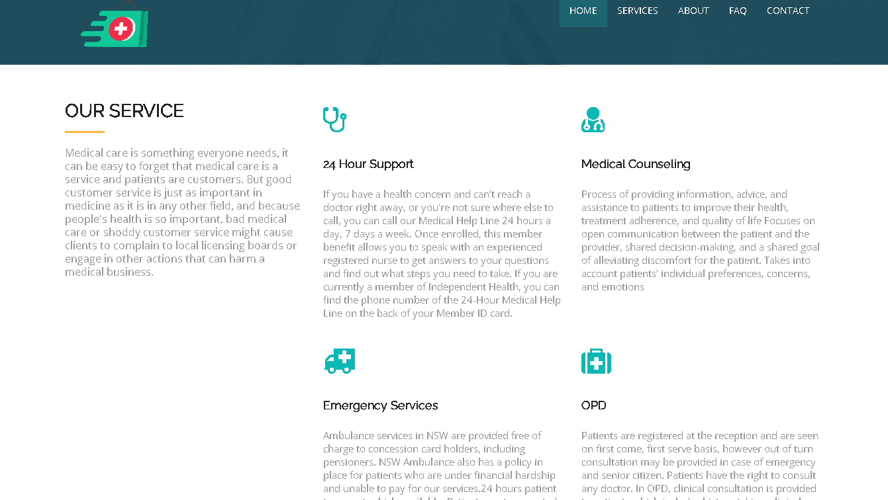

Slide 9
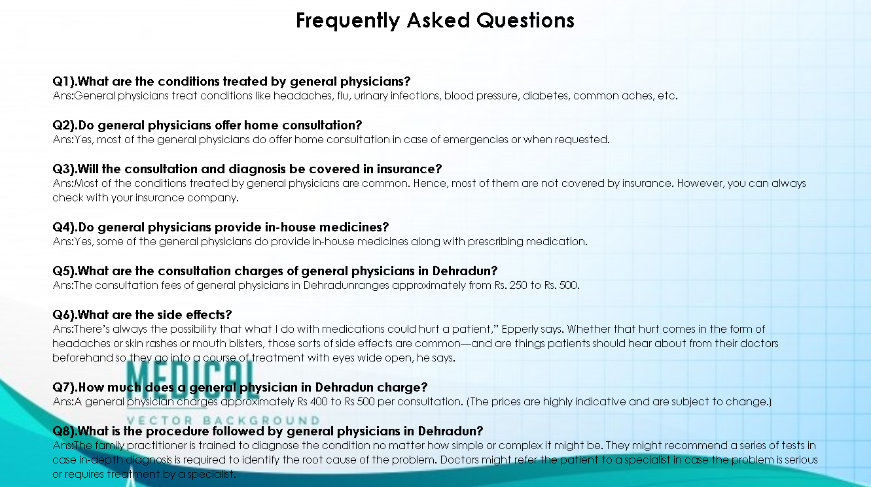

Slide 10
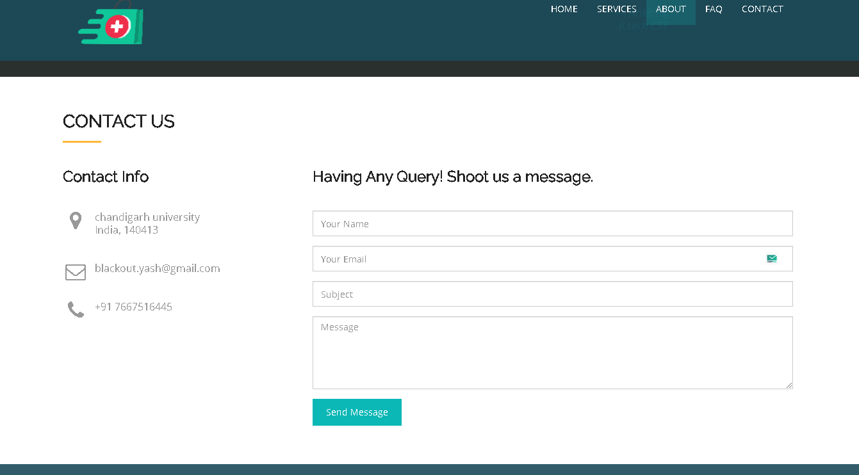

Slide 11
Thank You!

